Slide 1





Department of Electronics and Communications
Mini Project Presentation
ON
“GROUND WATER CONSERVATION”
TEAM MEMBERS:
P.DIKSHITH (22D41A0485)
P.SATHWIK (22D41A0494)
V.SNEHA (23D45A0412)
V.MUKTHAVALI (23D45A0413)

Slide 2
ABSTRACT
When communities cannot see or understand their collective water consumption patterns, they lose the ability to make informed decisions about resource sharing, conservation priorities, and future planning. Families may unknowingly consume excessive amounts while their neighbours face shortages, creating social tensions and inequitable access to this essential resource. The absence of transparent monitoring systems undermines community cooperation and shared responsibility for water stewardship. Hence the main goal of the work is to develop a system for monitoring the usage of groundwater and to establish some criterions and regulations based on the groundwater level and an automated system is created which monitors water level and water usage of the house.

Slide 3
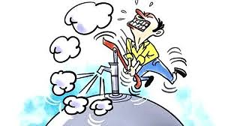
CONTEXT
▶ INTRODUCTION
▶ BLOCK DIAGRAM
▶ WORKING PRINCIPLE
▶ OUTPUTS
▶ PTOJECT SETUP
▶ PRACTICAL RESULTS
▶ ADVANTAGES
▶ CONCLUSION

Slide 4
INTRODUCTION
This project, titled "Under Ground Water Level Consumption Monitoring System– A Societal Perspective," focuses on monitoring household-level ground water usage through an automated and intelligent system. By integrating sensors, microcontrollers, and communication technologies, the system tracks water flow, alerts users when limits are reached, and even restricts usage until are charge (via payment) is made. The system utilizes MQTT protocol as a mediator between the hardware(ESP32) and a mobile dash-board, providing real- time data, notifications, and QR-based payment integration. This solution aims to bring awareness, control, and accountability to individual water usage, ultimately contributing to ground water conservation efforts on a societal level.

Slide 5
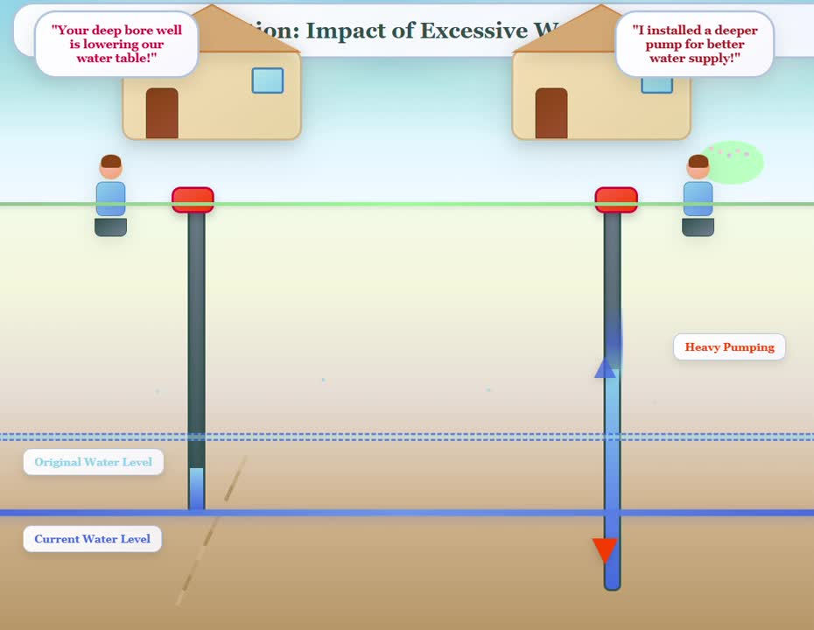

UNDER-STANDING THE
PROBLEM

Slide 6
GOAL
The system accurately tracks flow rate and cumulative water consumption, enforcing a predefined daily usage limit.
When the limit is exceeded, the system automatically disables water flow, notifies users via Node-RED, and generates a QR-based payment request for reactivation.
Additionally, if no payment confirmation is received, water supply is automatically restored to ensure accessibility to the next day(24hours).
The solution incorporates wireless connectivity, MQTT-based alerts, and real-time data visualization via Node-RED dashboards, enhancing usability and efficiency.

Slide 7

PRINCIPLE
ESP-32
MOSQUITTOBROKER
NODE-RED
MICRO-
CONTROLLER
MQTTP
DASH BOARD

Slide 8
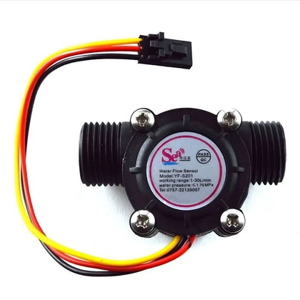

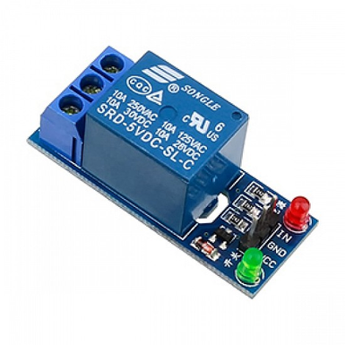
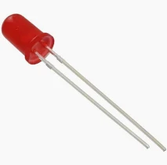
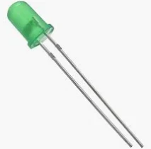
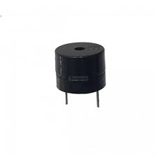
Water Flow Sensor:
VCC → 3.3V on ESP32
GND → GND on ESP32
Signal → GPIO 27 (or any interrupt-capable pin)
Used to measure water flow by sending pulses to the ESP32.
Relay Module (for solenoid):
IN → GPIO 23
VCC → 5V
GND → GND
freqency-0 to 300hz & 24 to 240V VAC&VDC
Allows ESP32 to switch the solenoid valve on/off safely.
COMPONENTS
Led LED (Error/Timeout Indicator)
Anode (+) → GPIO 5 (through 220Ω resistor
Cathode (–) → GND
Lights up during timeout, error, or
restricted access conditions.
Green LED (Flow/Normal Status):
Anode (+) → GPIO 2 (through 220Ω resistor)
Cathode (–) → GND
Turns on when everything is working normally or water is flowing.
BUZZER:
POSITIVE (+) → GPIO 19 (THROUGH RESISTOR IF NEEDED)
NEGATIVE (–) → GND
USED TO ALERT THE USER DURING TIMEOUT OR PAYMENT-REQUIRED STATE.

Slide 9



BLOCK DIAGRAM
GREEN LED
FLOW SENSOR
E
S
P
RELAY
LCD
RED LED
BUZZER

Slide 10
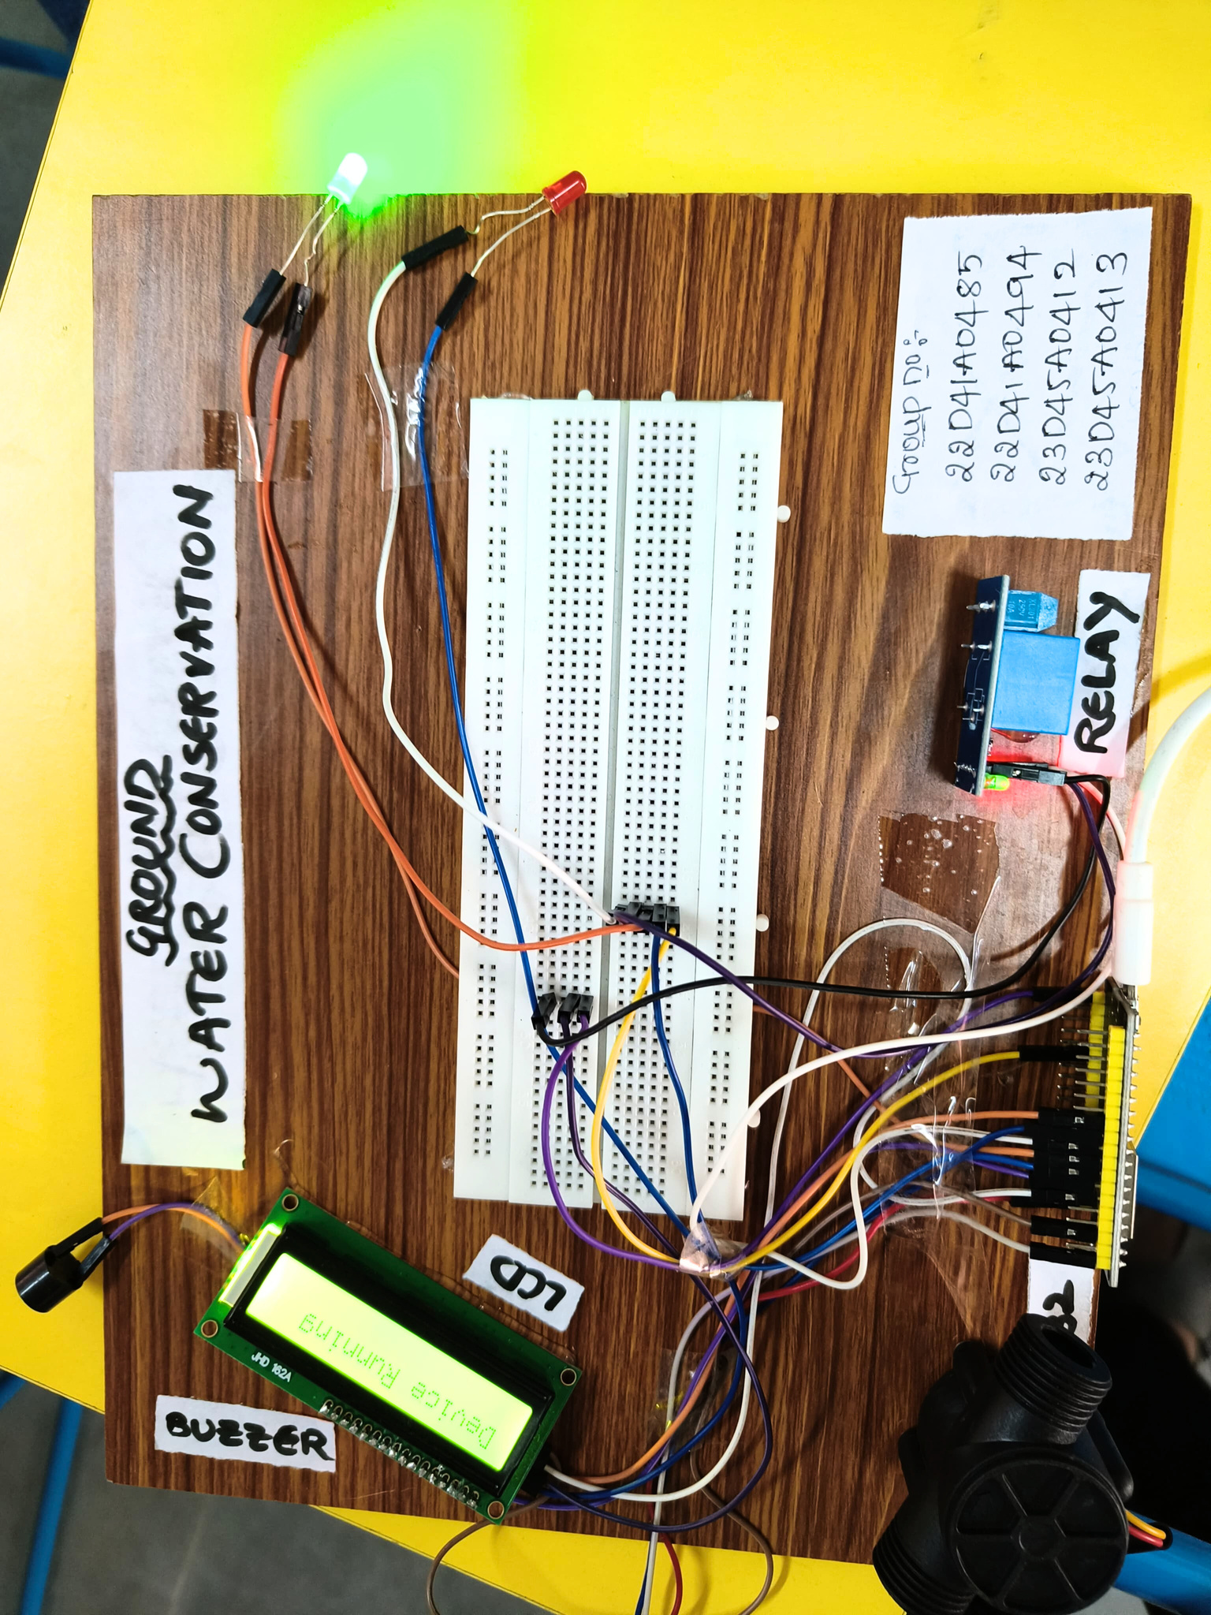
PROJECT VIEW

Slide 11
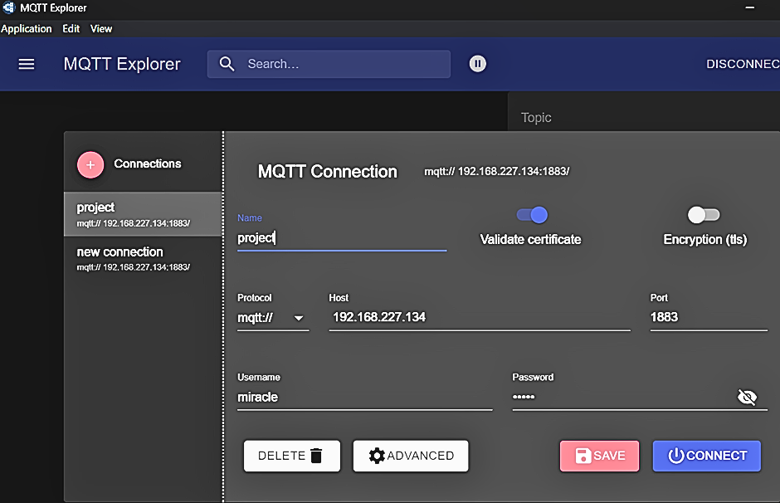

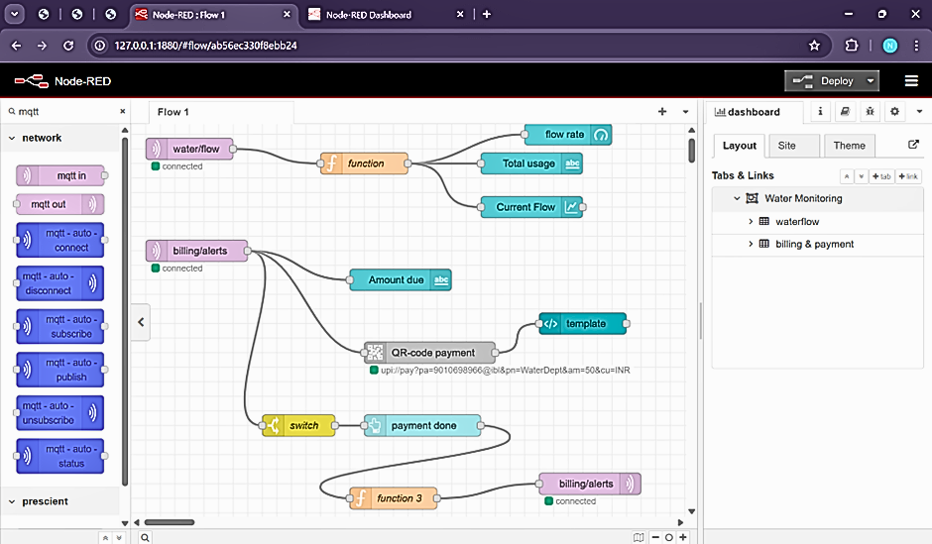
MOSQUITTO
BROKER
NODE
-RED

Slide 12

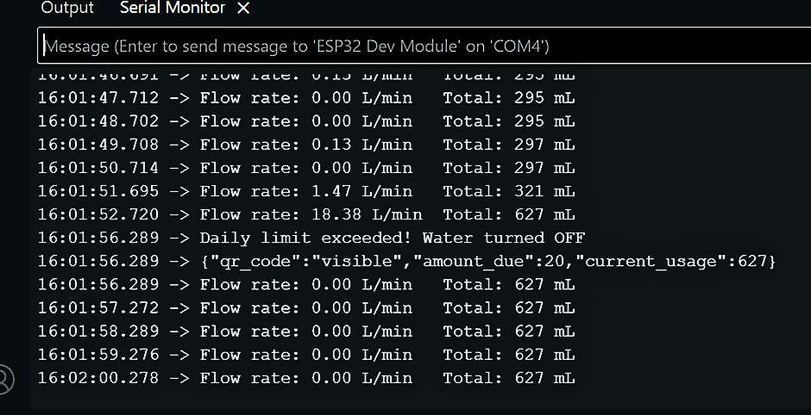
SERIAL MONITOR DISPLAY

Slide 13
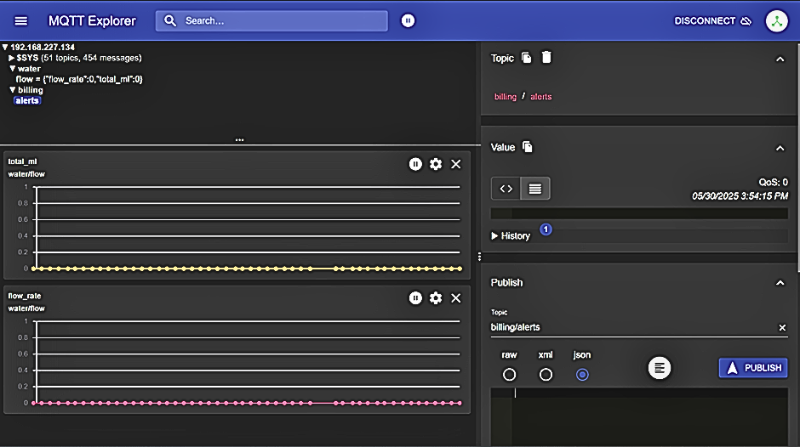

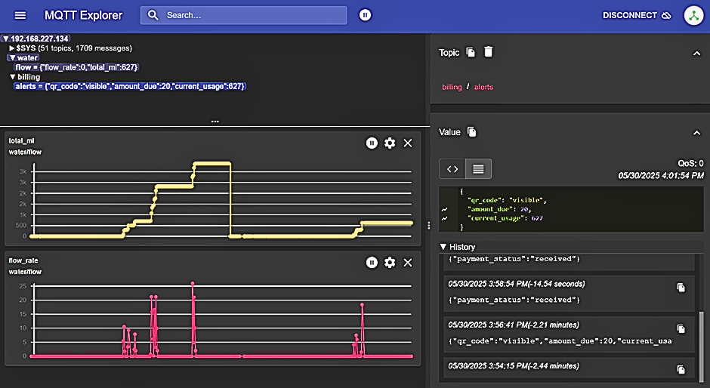
MQTTP
DISPLAY-1
(INITIAL)
MQTTP
DISPLAY-2

Slide 14
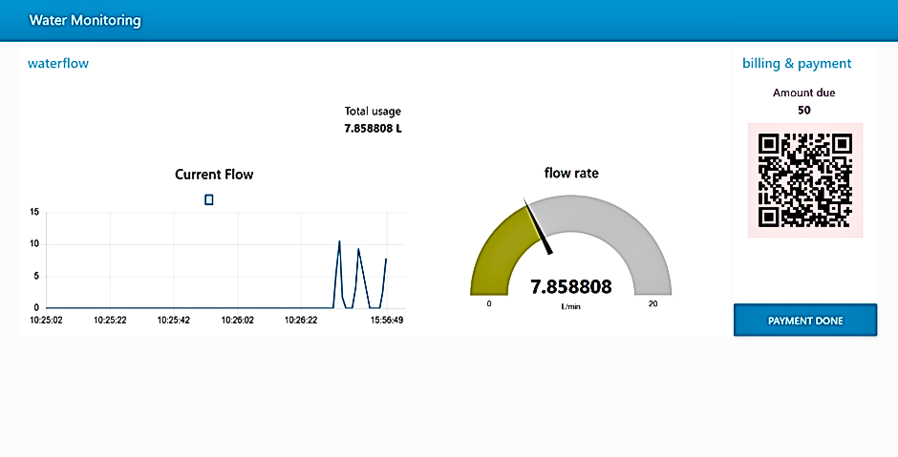
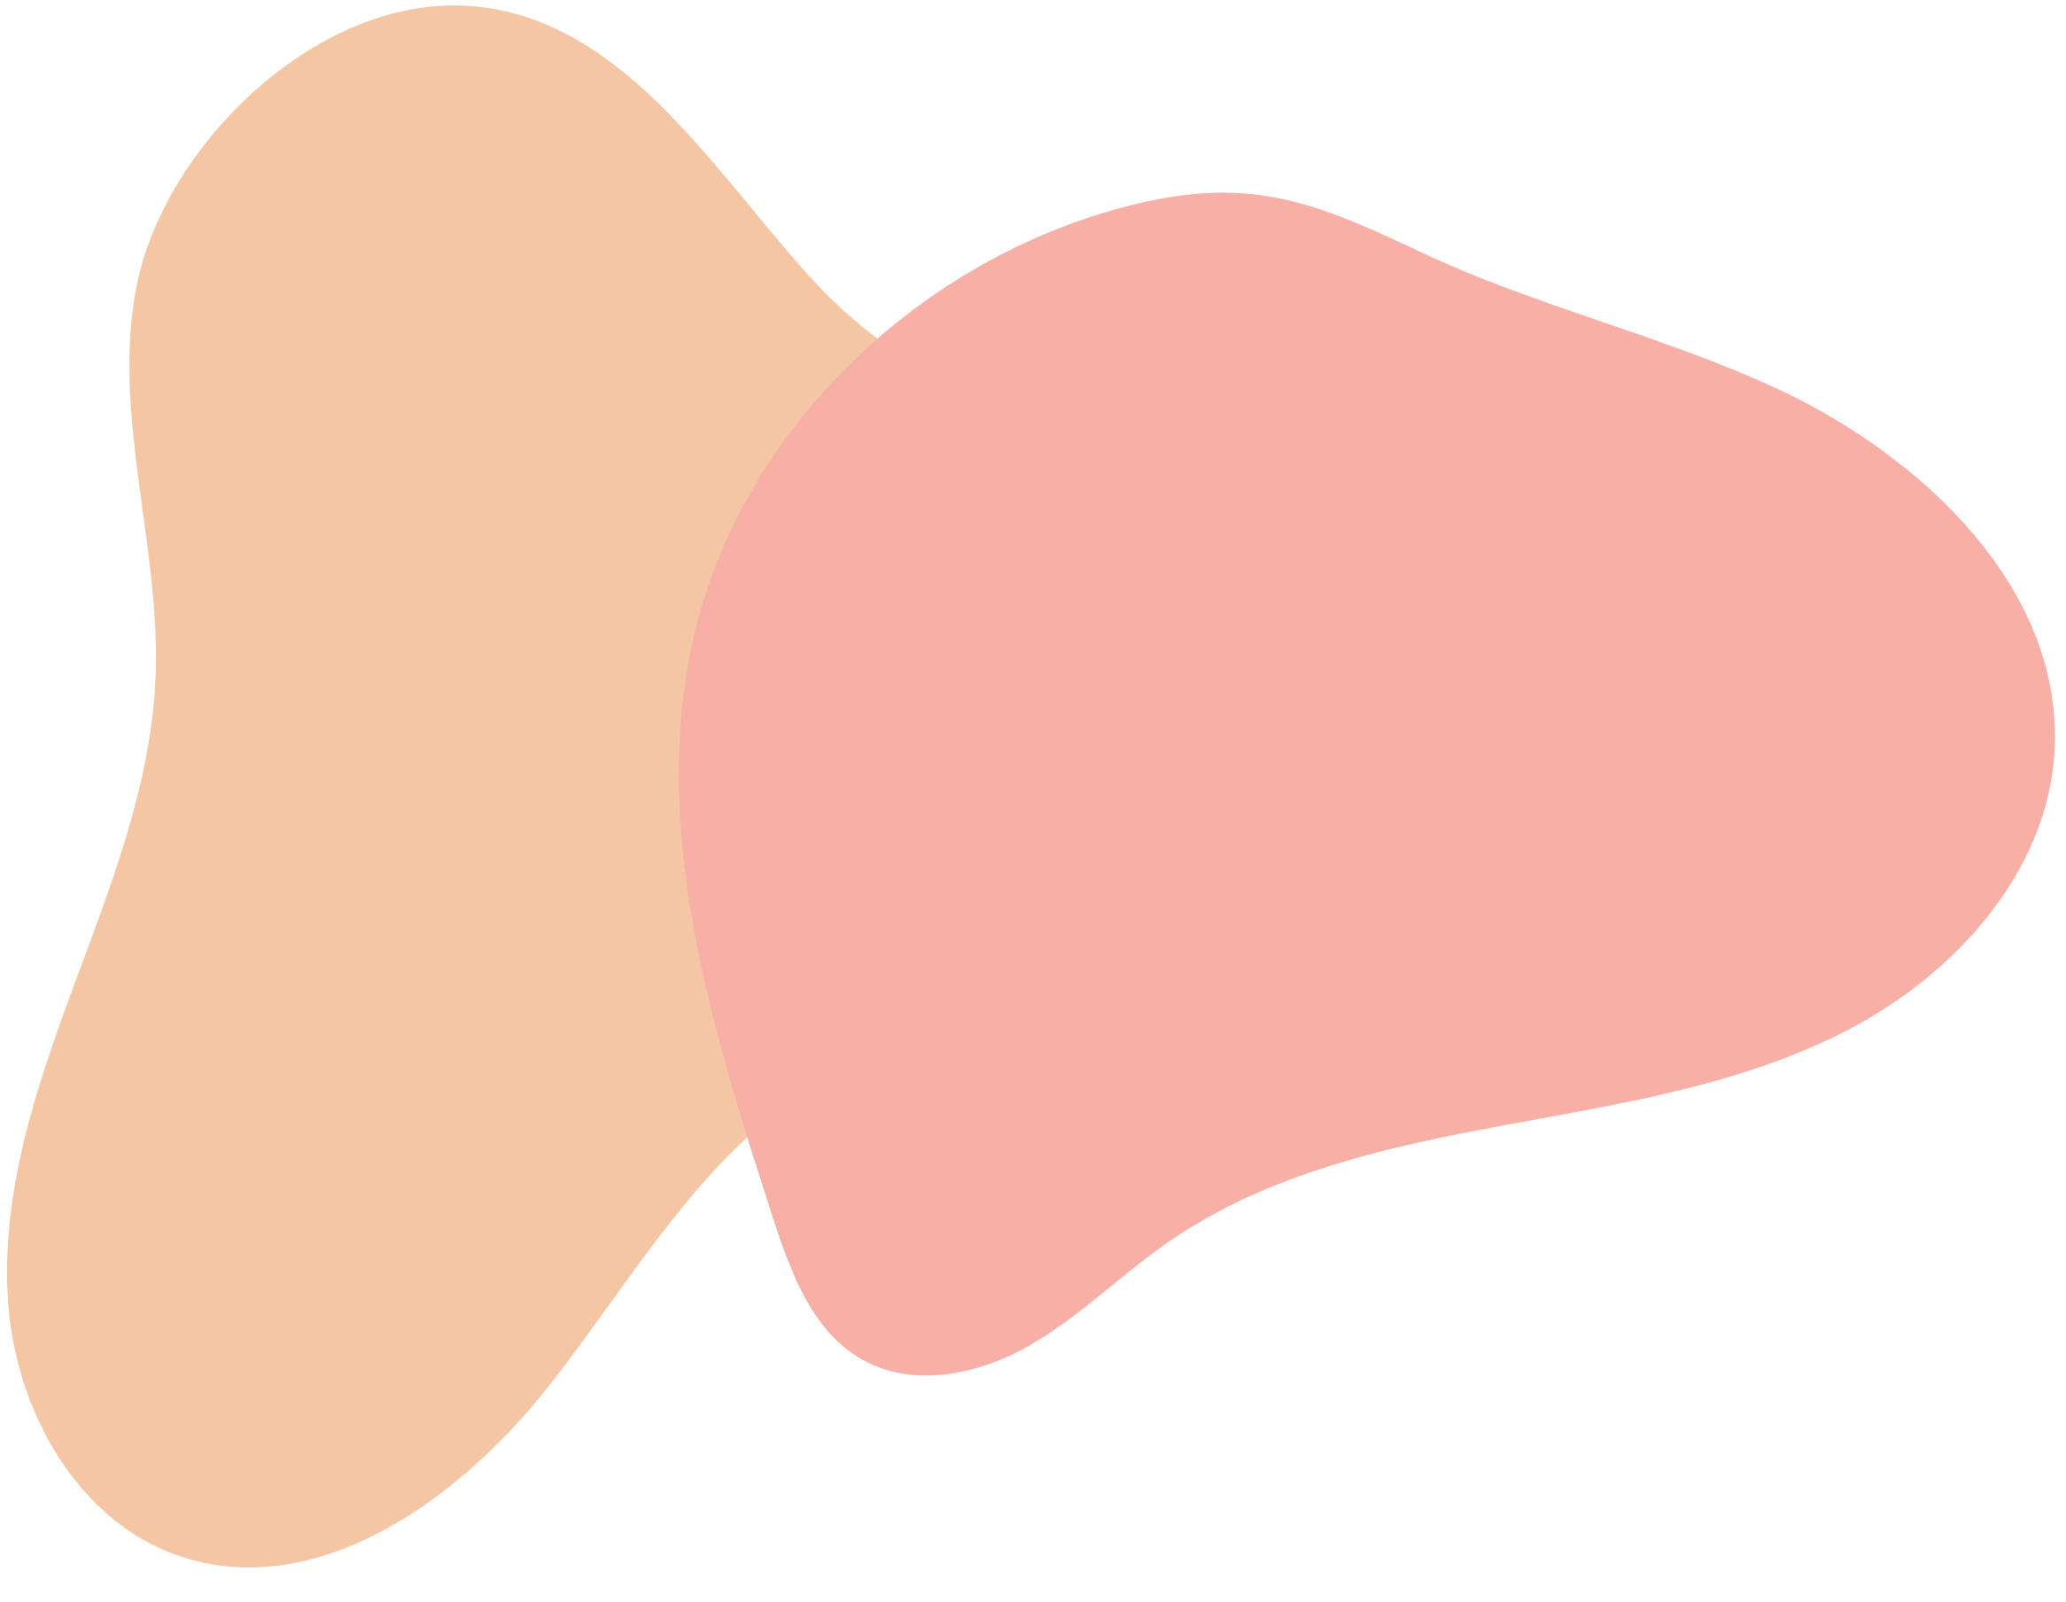
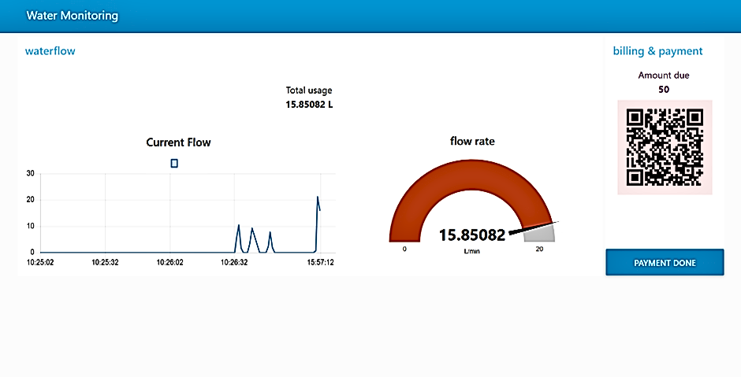

NODE-RED
DISPLAY- 1
(INITAL)
NODE-RED
DISPLAY-2

Slide 15
LONG-TERM BENEFITS
Advanced Data Analytics: Integrate predictive analytics to forecast water usage trends and detect anomalies using Power BI or a machine learning model.
User-Friendly Interaction: Improve the LCD interface by adding interactive touch controls or dynamic alerts for payment reminders and real-time feedback.
Enhanced Automation: Implement AI-based decision-making to autonomously adjust water flow based on consumption patterns or predefined efficiency rules.
Scalability: Upgrade your Node-RED dashboard to support multiple monitoring points, enabling city-wide tracking for smart water management.
Security Measures: Strengthen access control with QR-code authentication, encryption for MQTT messages, or real-time fraud detection mechanisms.
Remote Management: Develop a mobile app for users to monitor their water usage, receive notifications, and make payments on the go.

Slide 16
FUTURE GAINS
Government Applications
Agriculture & Farming
Environmental &
Sustainability
Water resource management – Enables efficient monitoring and regulation of groundwater usage.
Policy enforcement – Helps impose usage restrictions and tiered pricing for conservation.
Leak detection & waste prevention – Identifies anomalies to prevent unauthorized consumption.
Smart city initiatives – Supports infrastructure planning for long-term sustainability.
Disaster preparedness – Assists in drought & flood management with predictive analytics.
Optimized irrigation – Provides real-time monitoring for efficient water use.
Automated water control – Adjusts flow based on weather & crop needs.
Industrial & Commercial Use
Process optimization – Helps factories track usage and reduce costs.
Leak detection – Prevents water loss in large facilities.
Groundwater studies – Assists NGOs and researchers in mapping usage patterns.
Rainwater harvesting support – Encourages efficient water conservation.
Public awareness campaigns – Helps promote responsible water usage in communities.

Slide 17
CONCLUSION
This project ‘Under Ground Water Level Consumption Monitoring System’– solution aims to bring awareness, control, and accountability to individual water usage, ultimately contributing to groundwater conservation efforts on a societal level.

Slide 18
THANK YOU

